Slide 1
Further MATLAB Programming – Make Your Code Efficient and Robust
Louise Brown, Yijie (Amy) Zheng

Slide 2
Course Outline
Day 1 am: 0. Introduction to version control, git and github
1. The MATLAB Language and Desktop Environment
Day 1 pm: 2. Algorithm Design in MATLAB
Day 2 am: 4a. Machine Learning in MATLAB
4. Debugging and Improving Performance
Day 2 pm: 3. Test and Verification of MATLAB Code

Slide 3

What is Version Control? Why should I use it?
It’s all gone horribly wrong!
Helps us to keep track of what we did and when.
Even if you are not collaborating with other people it is better than this:
“Piled Higher and Deeper” by Jorge Cham, http://www.phdcomics.com

Slide 4

What is Version Control?
‘… a system that records changes to a file or set of files over time so that you can recall specific versions later’ ¹
Pro Git book, available online (free!)
¹ https://git-scm.com/book/en/v2/

Slide 5
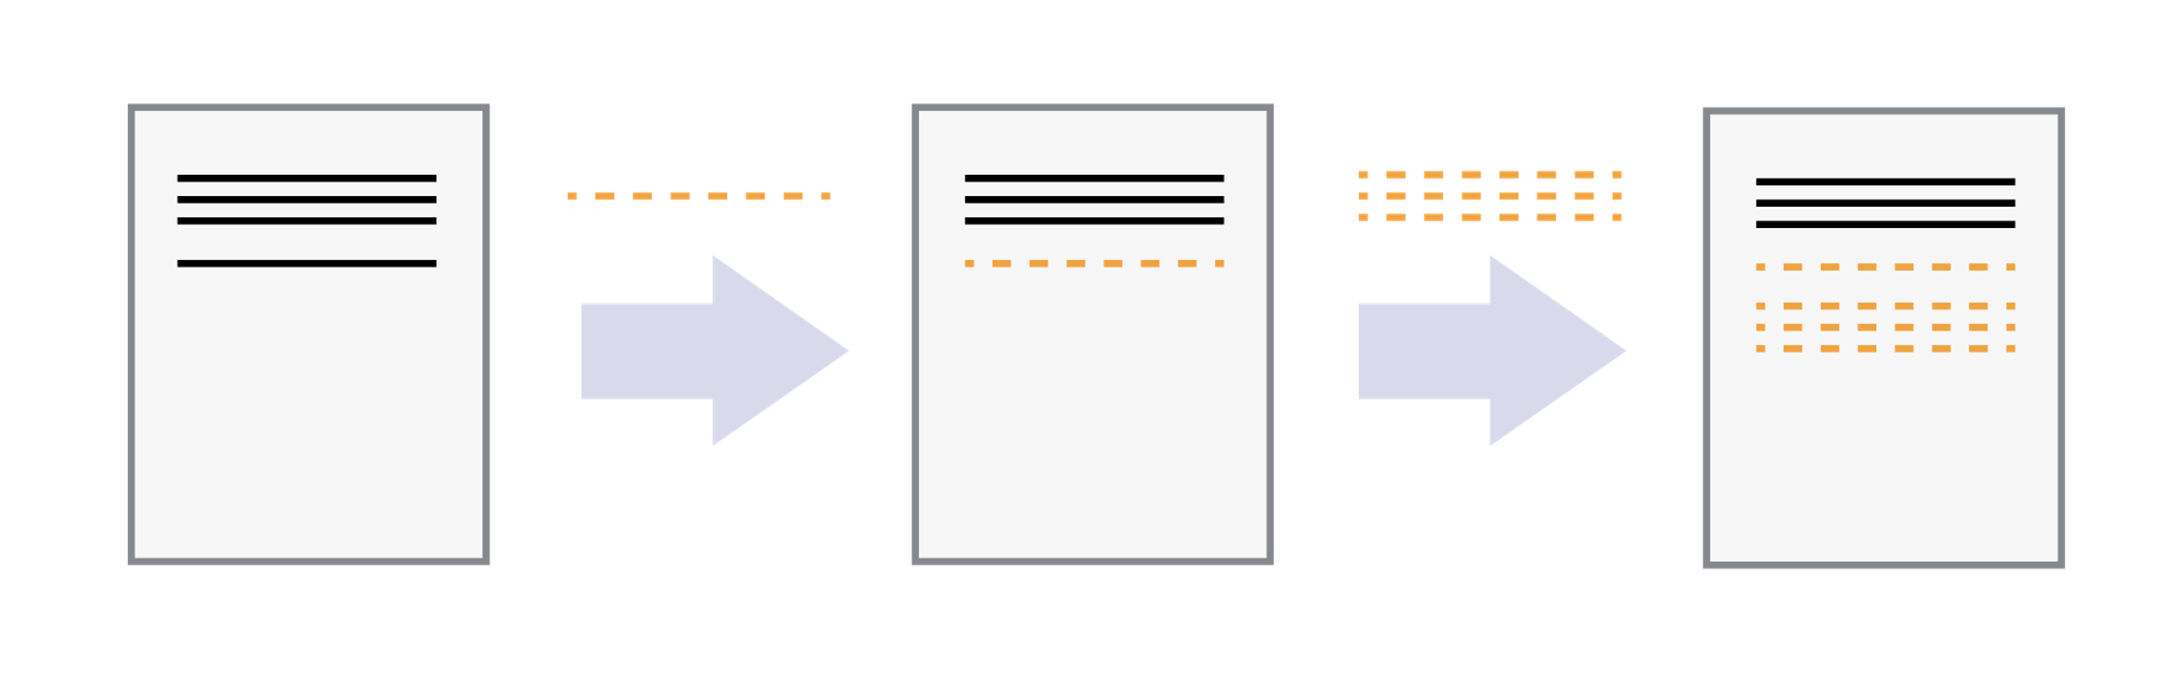
Save incremental changes to a file
Version control systems start with a base version
Changes are recorded at each step
It is possible to ‘rewind’ to a previous version

Slide 6
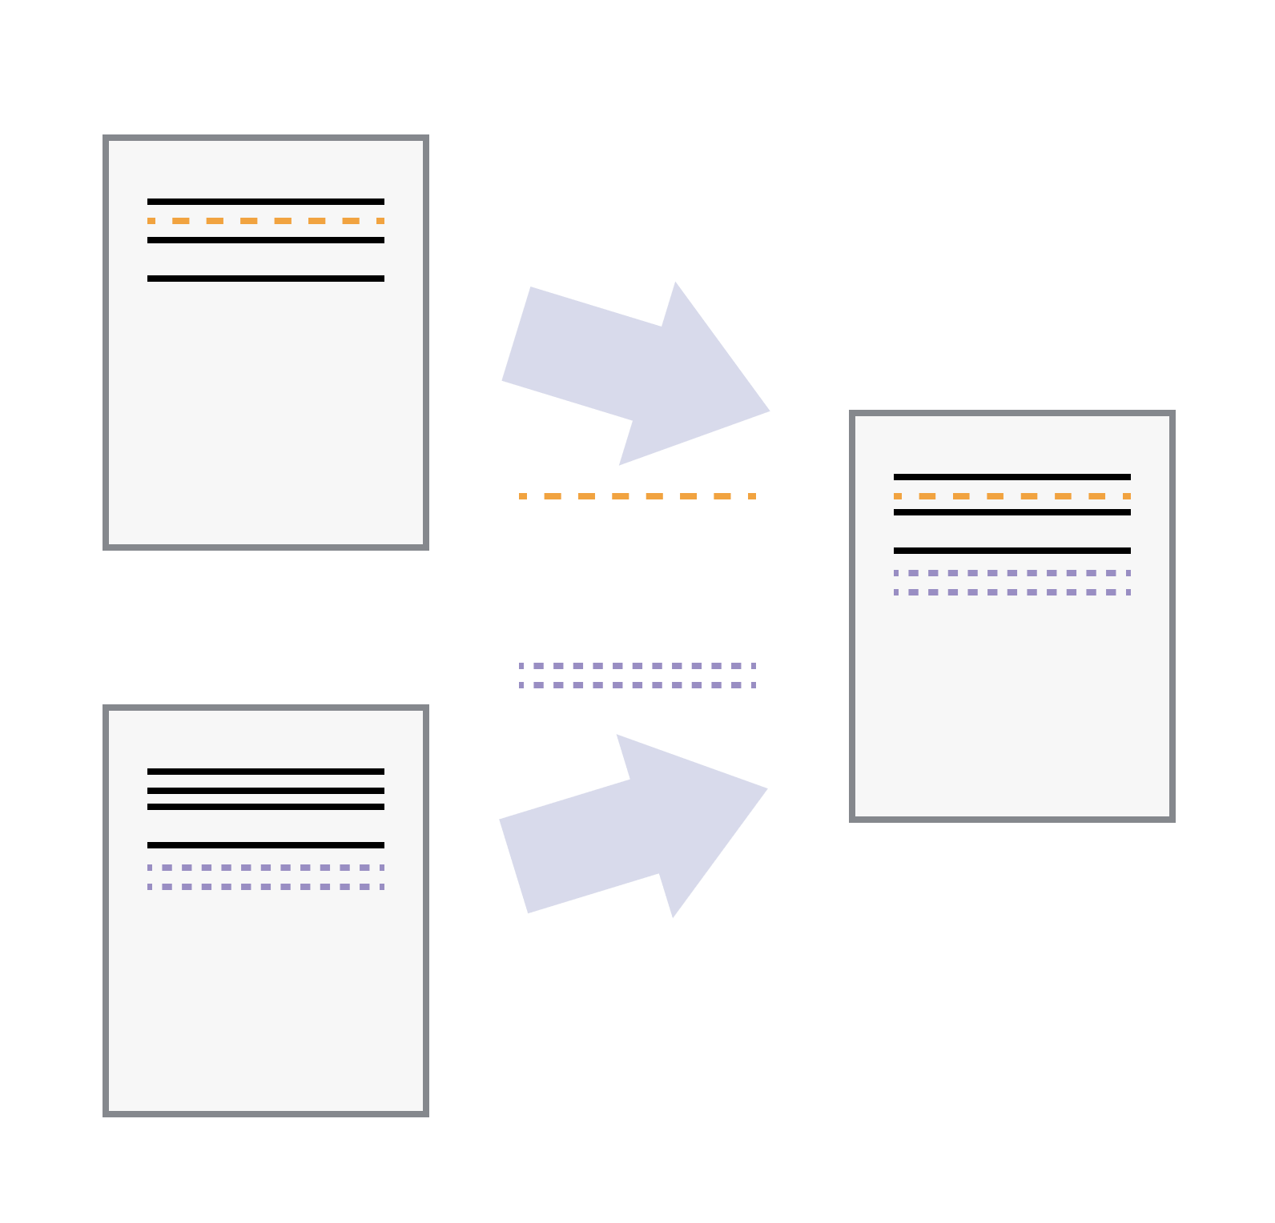
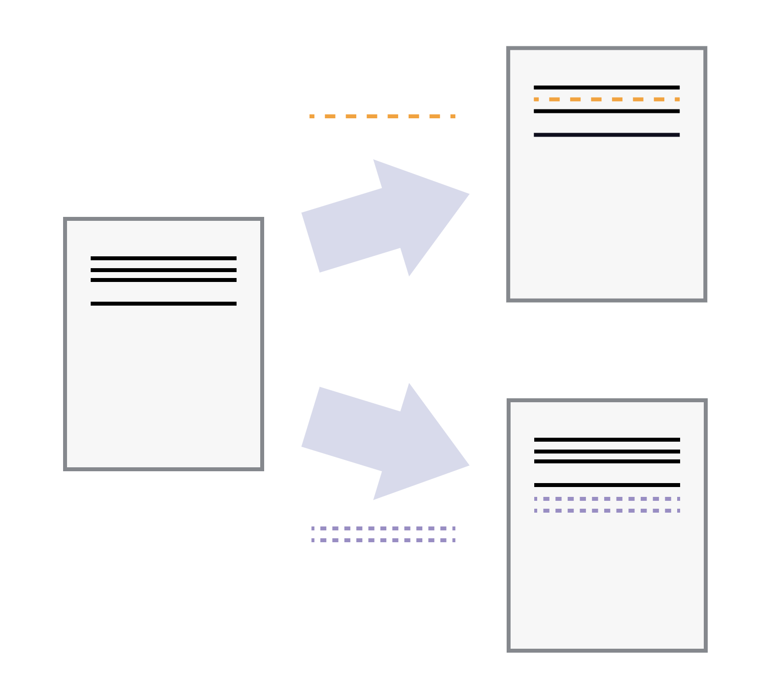
Multiple users can safely work on one file
Multiple users can make independent changes to the same document
Unless multiple users make changes to the same section of the document - a conflict - you can incorporate two sets of changes into the same base document.

Slide 7
Version control systems
A version control system is a tool that keeps track of these changes for us, effectively creating different versions of our files.
It allows us to decide which changes will be made to the next version (each record of these changes is called a commit), and keeps useful metadata about them.
The complete history of commits for a particular project and their metadata make up a repository.
Repositories can be kept in sync across different computers, facilitating collaboration among different people.

Slide 8
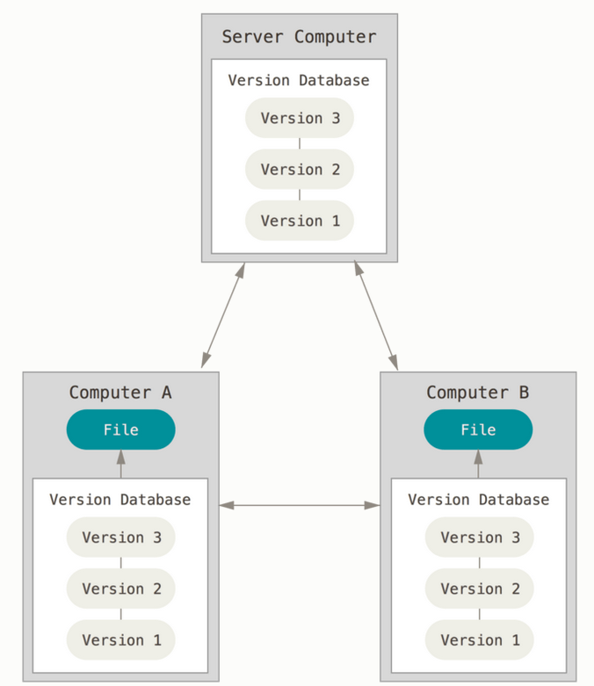
Distributed Version Control
We will be using Git which is a ‘distributed version control’ system
A distributed version control system replicates the whole repository on each machine.
Work can continue if the server is offline or if you have no internet access.
https://git-scm.com/book/en/v2/Getting-Started-About-Version-Control

Slide 9

Installing Git
To install on your own computer, visit https://git-scm.com/downloads
When using on a computer for the first time, the following configuration is needed
Set up name and email address
Open git bash command window using the icon on the desktop
Type:
git config --global user.name “Your name”
git config --global user.email Your@email.address

Slide 10
Where does Git store information?
The command git init will create a repository in the folder where the command was executed
This creates a hidden subfolder called .git
This contains all the information about the project, including files and sub-folders.
Do not manually change anything in this folder – the Git commands executed will do this for you
We will be using the MATLAB – GitHub – Git integration to create repositories

Slide 11
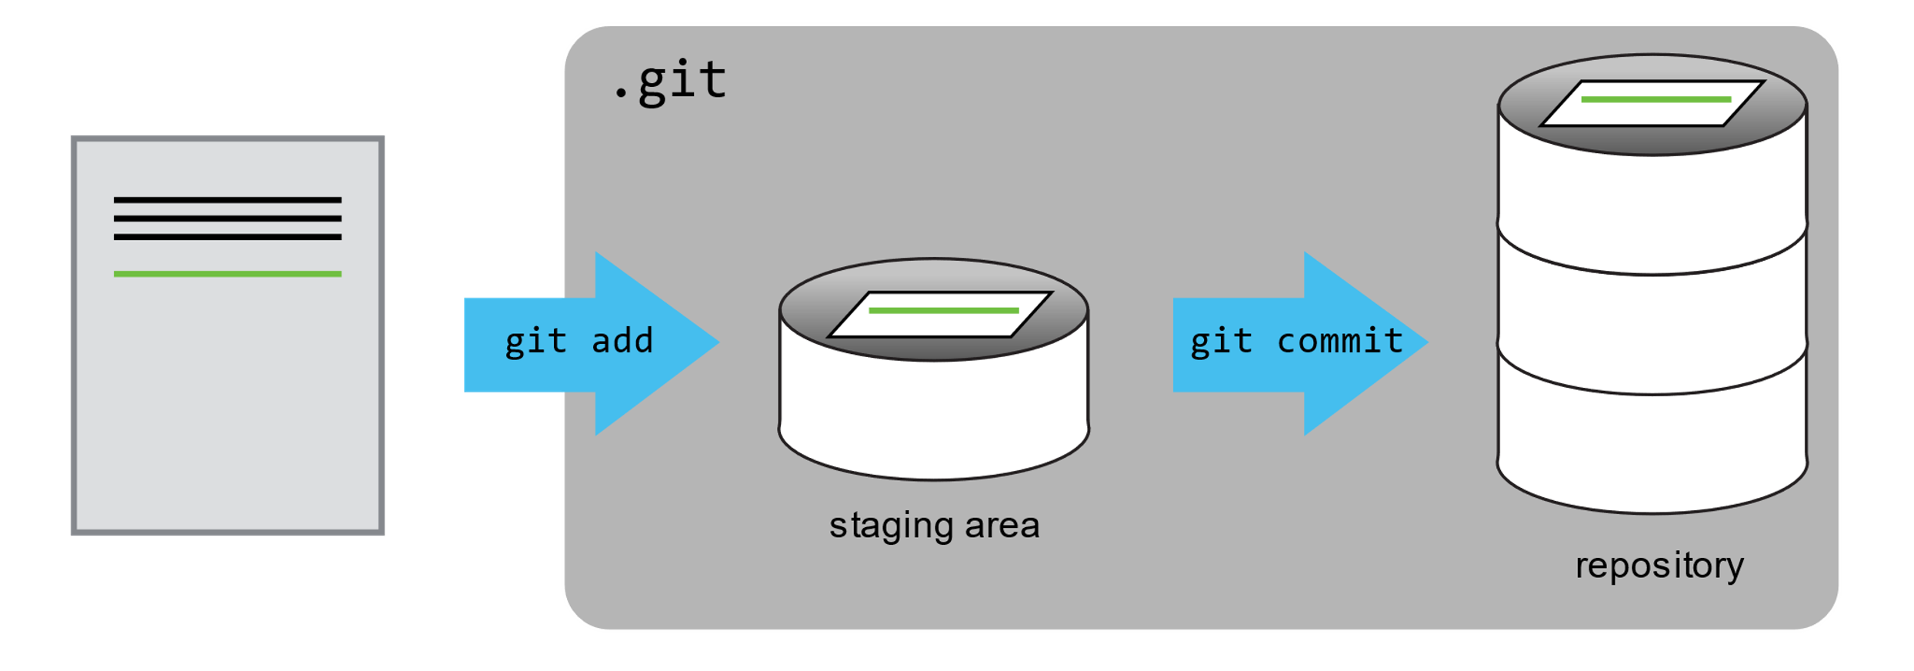
Tracking Changes - Git Workflow
Local
Working folder
Staging area
Local repo
git add
git commit
git checkout
git merge
Save one or more changes to go into the ‘snapshot’
Save the snapshot to the repository

Slide 12
Git Workflow – with remote
Local
Remote
e.g. GitHub
Working folder
Staging area
Local repo
Remote repo
git add
git commit
git push
git pull
git checkout
git merge

Slide 13
Git Workflow
It’s all gone horribly wrong!
5
8
10
Discontinued branch
Branch
2
3
6
7
1
4
9
Trunk
T1
Tag
T2
Tags can correspond to code producing results for research papers
Use git in MATLAB: https://uk.mathworks.com/help/matlab/matlab_prog/use-git-in-matlab.html

Slide 14
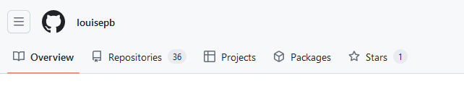
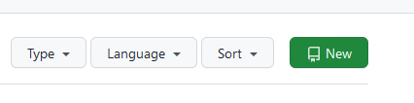
Integrate MATLAB and Git – Create a new repo
First, create a new repository in GitHub:
From your Home page, select the Repositories tab
Then select the ‘New’ button in the top right corner

Slide 15
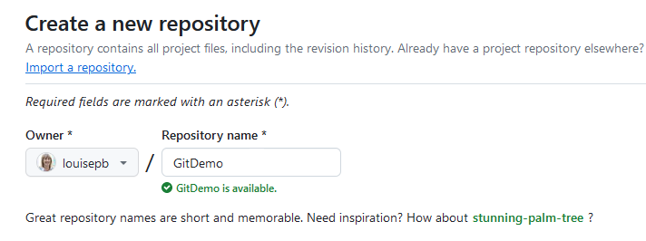
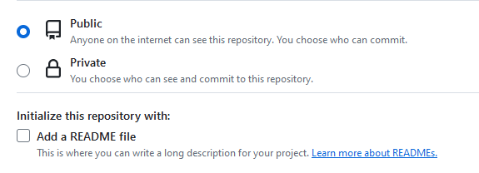

Create a repo on GitHub
Select a name for the repo
Decide whether it will be public or private (probably private if it’s for your coursework!)
Add a README file if desired
And finally, select the button at the bottom to create the repo

Slide 16
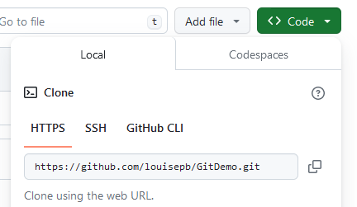
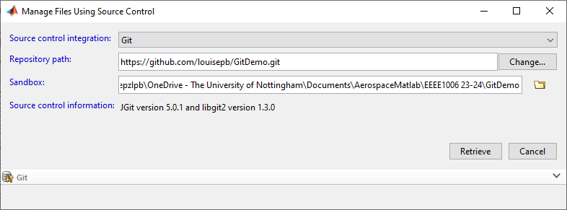
Clone your GitHub repo
Then create a clone of the code on your local drive
Select the Code button and copy the address
Go back to MATLAB
Right click in Current Folder Window
Select Source Control -> Manage Files…
Select an empty folder (ideally with the same name as your repo) to clone into
Create a new folder if necessary

Slide 17
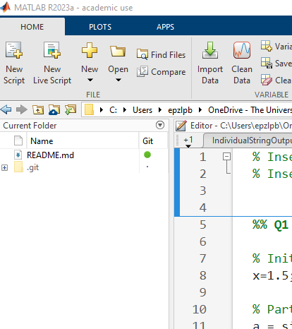
View repo in MATLAB
The cloned repo is now visible in MATLAB
The README file is there
Note the .git folder (don’t do anything to this!)
You are now ready to add files and keep a record of changes using Git !

Slide 18
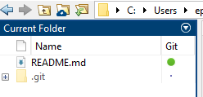
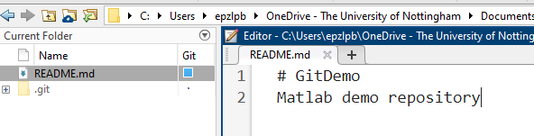
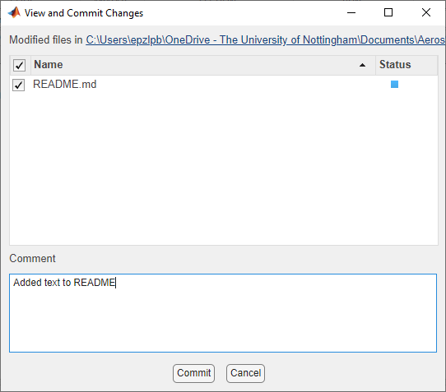
Saving changes to a file in the local repo
The README file is up-to-date (shown by the green dot)
Make a change to the file and save. The blue square shows that there is an unstaged change
Right click in the Current Folder window and select ‘Source Control -> View and Commit Changes…’
Add a commit message in the dialog
Note that the MATLAB integration combines the staging (add) and commit instructions
Select ‘Commit’
The file will now show as up-to-date again
(Note that this has not yet been synced with the remote repo

Slide 19
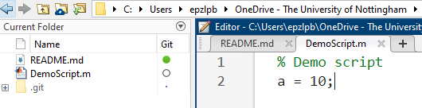
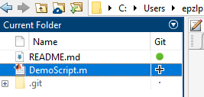
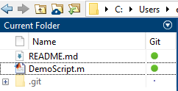
Adding new files to the local repo
A new file, DemoScript.m, is added to the folder. The empty circle shows that this file is not tracked in the repo
Right click on the filename and select ‘Source Control -> Add to Git’
A + sign now indicates that the file has been added to the repo
The file can now be committed to the repo as described in the previous slide
The green dot shows that this file is now saved in the repo

Slide 20
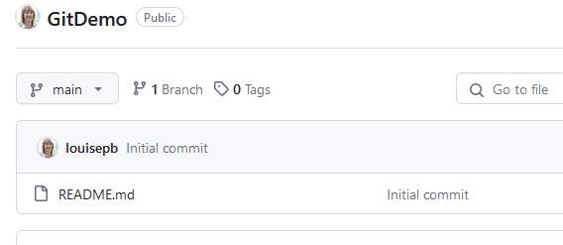
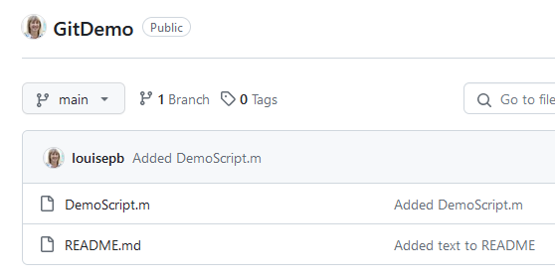
Saving to the remote repo
The files are now safely committed in the local repo but have not yet been backed up to the remote one
GitHub still only shows the initial creation of the README file
Right click in the Current Folder window and select ‘Source Control -> Push
You may be asked to verify your GitHub credentials at this point
Refresh the GitHub page and the new files will be shown
The local and remote repos are now synced

Slide 21
Content adapted from Software Carpentry material
Some of the content and figures in this presentation are adapted from the Software Carpentry Version Control with Git: Beginner lesson, made available under the Creative Commons Attribution license
Copyright © 2018–2022 The Carpentries Copyright © 2016–2018 Software Carpentry Foundation

Slide 22
Fork and Clone Course Materials
louisepb/Further-MATLAB-Student-Materials on GitHub
Fork the repo into your own GitHub account
Clone the repo into Further-MATLAB-Student-Materials folder on your local machine
Run setupPath.m
Notes:
Try
Might want different configurations for different computers, no of screens etc

Slide 23
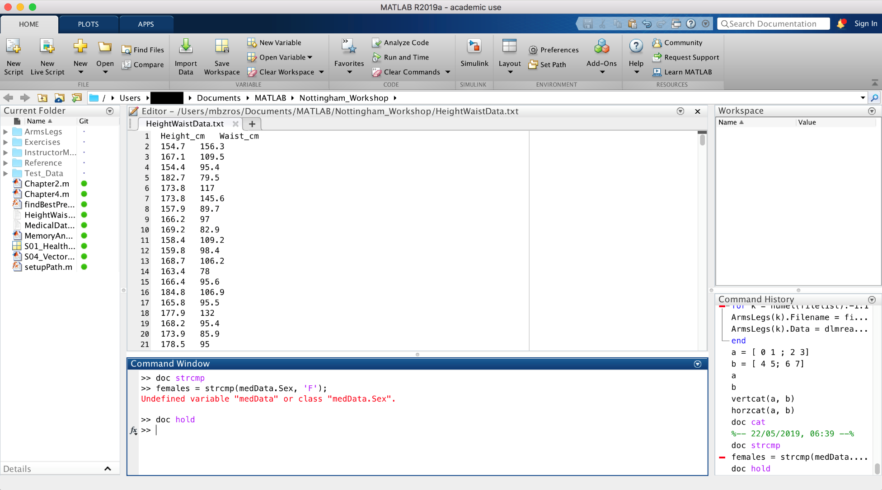
The MATLAB Desktop
Notes:
Try
Might want different configurations for different computers, no of screens etc

Slide 24
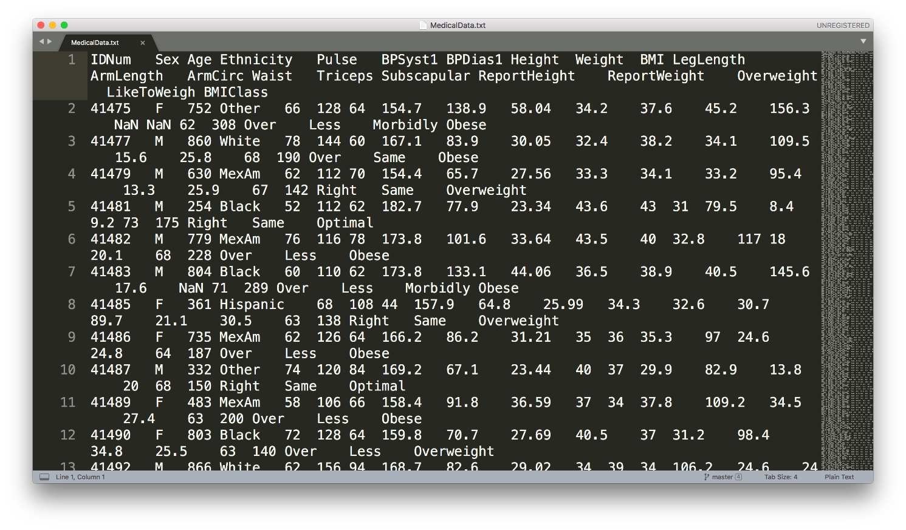
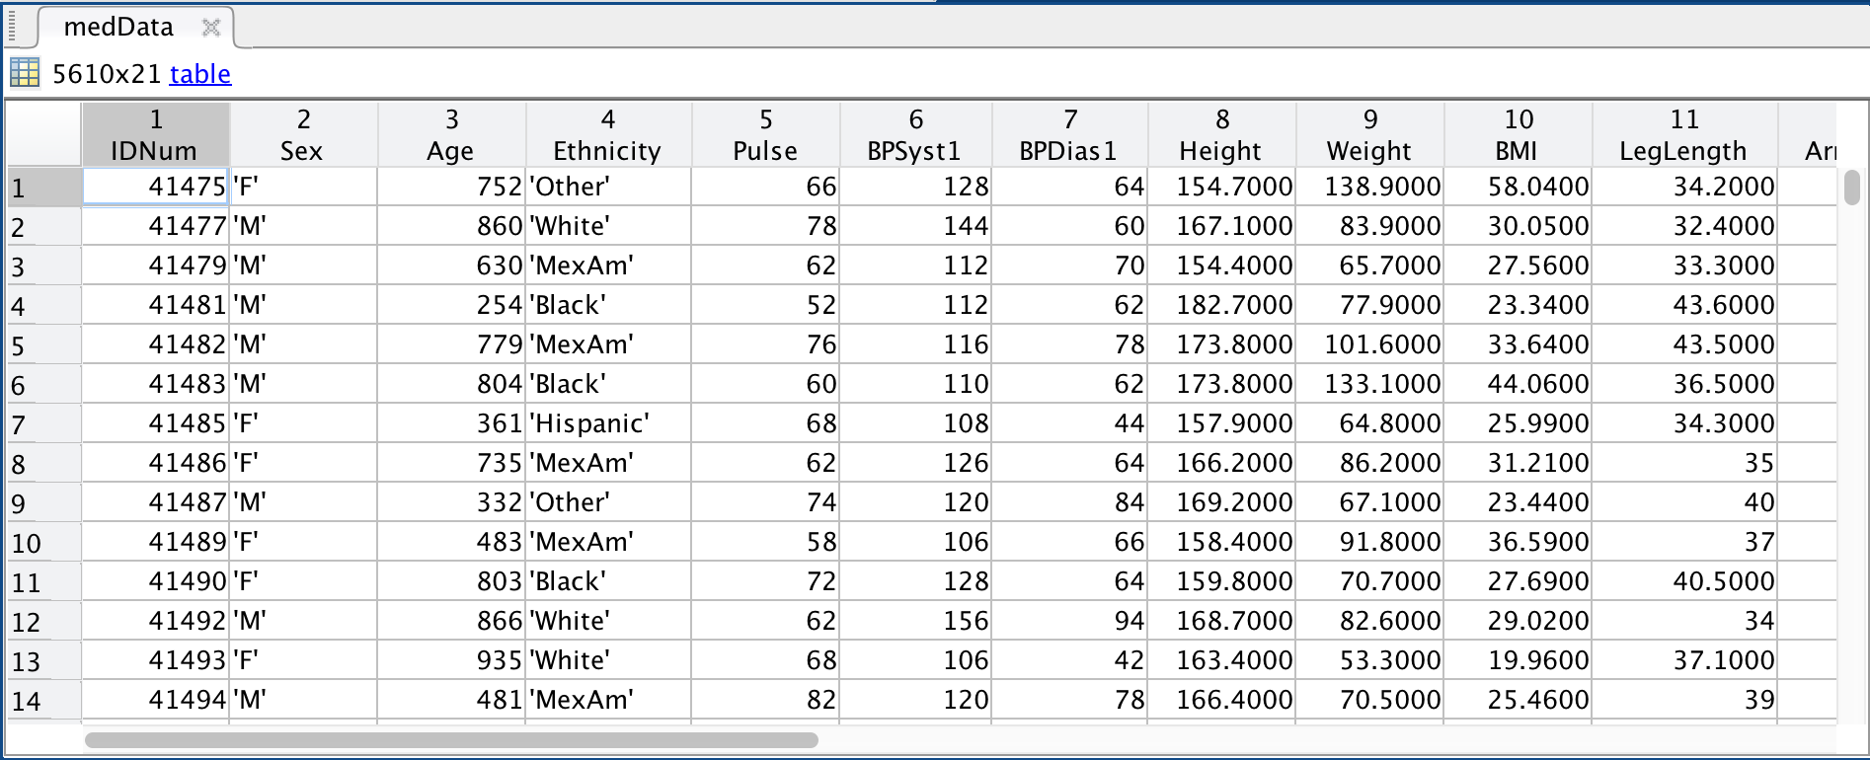
Heterogeneous data
doc readtable

Slide 25
Tables
Useful for heterogenous, column oriented or tabular data
Variables can have different data types
All columns must have the same number of rows
Not restricted to column vectors (eg could have matrix but number of rows condition still applies
Create table from workspace data using the table function:
TableName = table(var1, var2, var3,… );
or by using readtable to load a data set:
TableName = readtable(‘data.dat’);
Notes:
load patients
whos to show data
PatientData = table( Gender, Age, Height, Weight );
AllPatientData = readtable(‘patients.dat’);

Slide 26
Indexing into Tables
Address column data using dot notation:
PatientData.Gender % Accesses the whole column
Then normal indexing for the data type:
PatientData.Gender(10) % Accesses data in column
Access particular rows and columns using subscript notation:
PatientData(1:3, :);
ans =
Gender Age Height Weight
________ ___ ______ ______
'Male' 38 71 176
'Male' 43 69 163
'Female' 38 64 131
Notes:
PatientData(1:3, : )

Slide 27
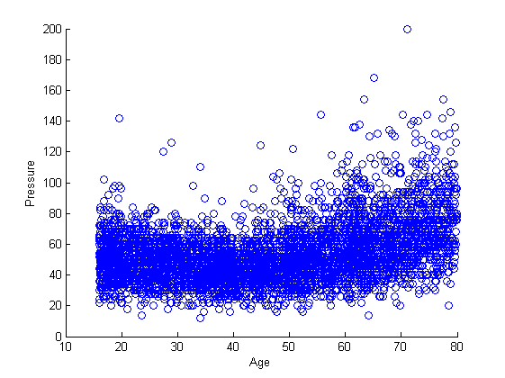
Plotting vectors
figure % new figure
% basic plot
scatter(medData.Age, medData.BPDiff)
xlabel(‘Age’)
ylabel(‘Pressure’)

Slide 28
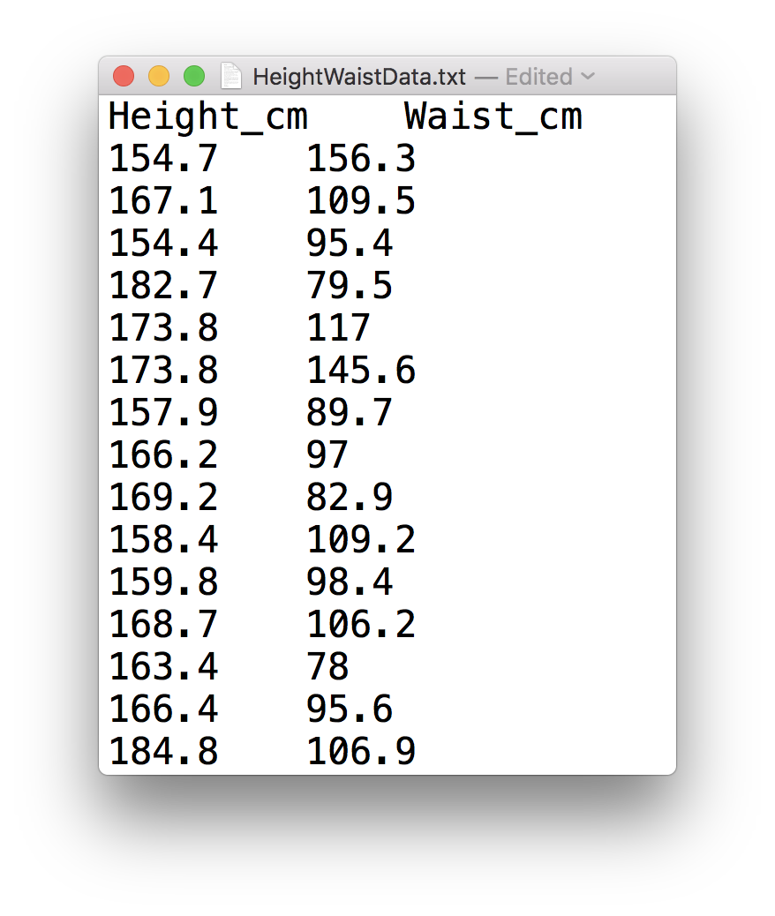
Low-Level file I/O
fileID = fopen(‘HeightWaistData.txt’);
dataFormat = ‘%f %f’;
heightWaistData = textscan(fileID, dataFormat, ...
‘HeaderLines’, 1, ‘Delimiter’, ‘\t’);
fclose(fileID);

Slide 29
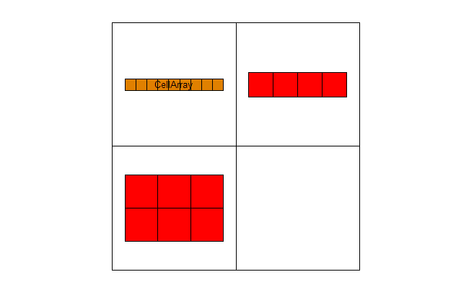
Cell Arrays
Store different types of data
Accessed by index
Particularly useful for storing different length strings
Can be used for importing spreadsheet data with different data types in the cells
>> A = ‘CellArray‘
>> B = 1:4;
>> C = [1:3,2:4];
>> CellArray = {A B; C []}
Curly brackets to specify cell array
Must specify empty elements or MATLAB will generate error
Visualise array using cellplot command
celldisp displays cell array contents
Notes:
If store strings in ordinary array stored as arrays of chars -> strings in each row must be consistent length
Specify empty elements or will complain about being inconsistent

Slide 30
Accessing Cell Array Data
Note difference between use of () and {}:
Use CellArray(m,n) to display data structure
>> CellArray(1,2)
ans =
[1x4 double]
Use CellArray{m,n} to display contents of the cell
>> CellArray{1,2}
ans =
1 2 3 4
To access individual elements within a cell use ():
>> % second element of array at cell position (1,2)
>> CellArray{1,2}(2)
ans =
2

Slide 31
Extending Cell Arrays
Note that array is padded to keep rows and columns consistent
Add more cells using the {} notation:
>> CellArray{3,3} = 1:4
CellArray =
'CellArray' [1x4 double] []
[2x3 double] [] []
[] [] [1x4 double]
Preallocate cell arrays using the cell function:
cell(10,10) creates an empty 10x10 cell array
Notes:
Exercise 11.2 p 44

Slide 32
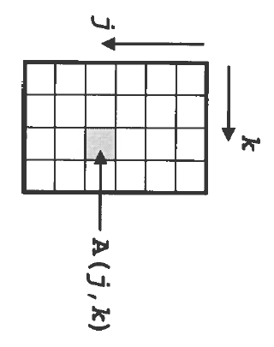
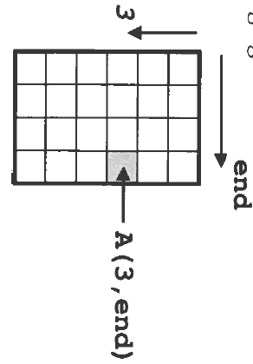
Accessing Data in Arrays
>> x = A(j,k)
Row Column
>> x = A(3,end)

Slide 33
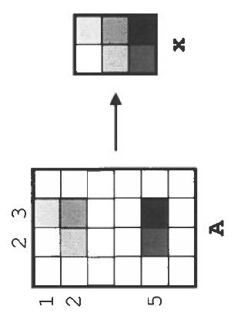
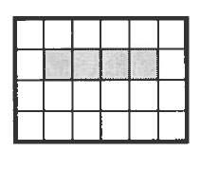
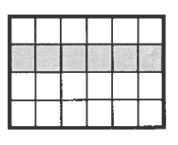
Accessing Multiple Elements
Use a vector of indices to reference multiple elements:
>> x = A([1,2,5],[2,3]);
Use colon notation to indicate a range of rows and/or columns:
>> x = A(2:5, 3);
>> x = A(1:6, 3);
>> x = A(1:end, 3);
>> x = A(:, 3);
all extract the entire third column.

Slide 34
Dealing with Missing Data
Bad or missing data will be imported as NaN
This can be removed using logical indexing
Gives logical vector with value of 1 where data is NaN
badData = isnan(Height);
CleanHeight = Age(~badData);
Use ~ (not) so that good data has value of 1 in logical vector
Notes:
Use Age.mat to demonstrate
Exercise 12.1, p48

Slide 35
Structures
Related data grouped together in fields which are referred to by name
alternate field names and contents
Create by:
>> cars = struct( 'year', 2010, 'colour','red','mpg', 35)
cars =
year: 2010
colour: 'red'
mpg: 35
Or:
>> cars.year = 2010;
>> cars.colour = ‘red’;
>> cars.mpg = 35;
Notes:
Show creation of structure and how it appears in workspace
Typically if find passing same group of variables around functions should probably be in structure
Stress that even if don’t use structures themselves, need to understand how to use as used in built-in functions

Slide 36
Arrays of Structures
Create arrays of structures either by adding another structure:
cars(2) = newcar;
Or by assigning new elements directly:
>> cars(3).year = 2012;
>> cars(3).colour = ‘blue’;
>> cars(3)
ans =
year: 2012
colour: ‘blue
mpg: []
Any unassigned fields will be present in the structure but will be empty
 | year | colour | mpg
cars(1) | 2010 | red | 35
cars(2) | 2008 | black | 42
cars(3) | 2012 | blue
Notes:
Can add completed structure, or elements of new ones
Demonstrate addition of extra fields
NB fields must be in same order for structures to be considered the same
Field names can’t have spaces

Slide 37
Combining Matrices
Larger arrays can be built up from smaller ones:
>> A = [1:5;5:9]
A =
1 2 3 4 5
5 6 7 8 9
>> B = [1:2:9;2:2:10]
B =
1 3 5 7 9
2 4 6 8 10
Square brackets [] are the concatenation operator
Delimiters:
, or space – Arrays go side by side
; - Arrays go one above the other
Note that the dimensions of arrays being joined must be consistent.
5 columns in both
>> D = [A;B]
D =
1 2 3 4 5
5 6 7 8 9
1 3 5 7 9
2 4 6 8 10
2 rows in both
>> E = [A, B]
E =
1 2 3 4 5 1 3 5 7 9
5 6 7 8 9 2 4 6 8 10
Notes:
Effectively same as the way that vectors are stacked to make matrices
Could also have put side by side: [A B]

Slide 38
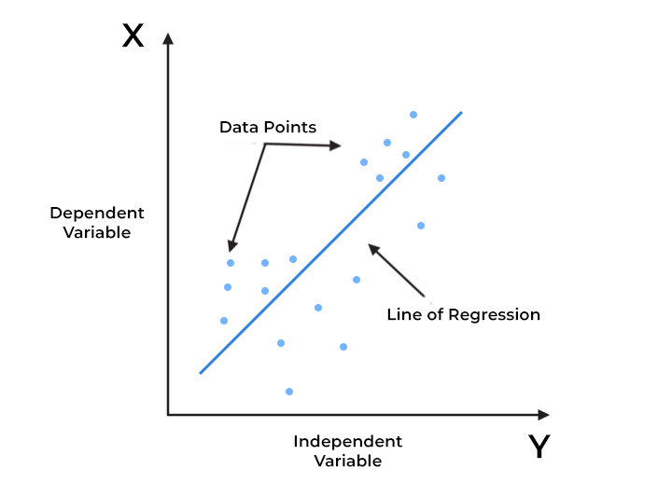
Linear Regression Models
Regression is the process of using measured data to fit a model of a relationship between variables
In this case between pulse pressure (dependent variable) and age (independent variable)

Slide 39
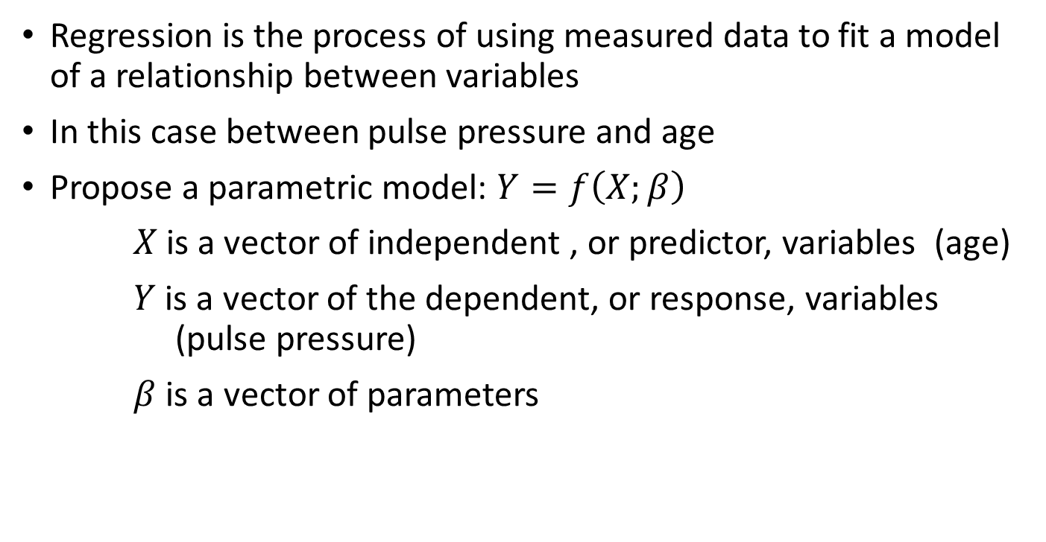
Linear Regression Models
Regression is the process of using measured data to fit a model of a relationship between variables
In this case between pulse pressure and age
Propose a parametric model: $Y=f\left(X;β\right)$
$X$is a vector of independent , or predictor, variables (age)
$Y$ is a vector of the dependent, or response, variables (pulse pressure)
$β$ is a vector of parameters

Slide 40
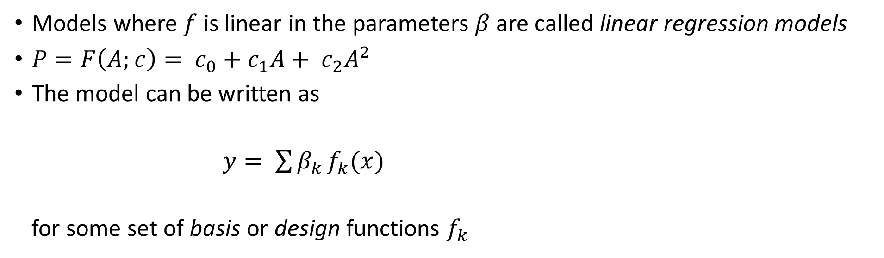
Linear Regression Models
Models where $f$ is linear in the parameters $β$ are called linear regression models
$P=F\left(A;c\right)= c_{0}+c_{1}A+ c_{2}A^{2}$
The model can be written as
$y= \sum{β_{k }f_{k}(x)}$
for some set of basis or design functions $f_{k}$
Response
Predictor
Model parameters
Design functions

Slide 41

Matrix Equations
Fitting n measured data points gives a system of n linear equations with m unknown model parameters (c_{j})
$$y_{1} = c_{1}f_{1}\left(x_{1}\right)+ c_{2}f_{2}\left(x_{1}\right)+ …+c_{m}f_{m}(x_{1})$$
$$y_{2} = c_{1}f_{1}\left(x_{2}\right)+ c_{2}f_{2}\left(x_{2}\right)+ …+c_{m}f_{m}(x_{2})$$
$$⋮$$
$$y_{n} = c_{1}f_{1}\left(x_{n}\right)+ c_{2}f_{2}\left(x_{n}\right)+ …+c_{m}f_{m}(x_{n})$$
Using matrix algebra, this system can be written in matrix-vector form as:
$$y_{1} = f_{1}\left(x_{1}\right) f_{2}\left(x_{1}\right) …{ f}_{m}\left(x_{1}\right){ c}_{1}$$
$$y_{2} = f_{1}\left(x_{2}\right) f_{2}\left(x_{2}\right) …{ f}_{m}\left(x_{2}\right){ c}_{2}$$
$$⋮$$
$$⋮$$
$$⋮$$
$$⋱$$
$$⋮$$
$$⋮$$
$$y_{n} = f_{1}\left(x_{n}\right) f_{2}\left(x_{n}\right) …{ f}_{m}\left(x_{n}\right){ c}_{m}$$

Slide 42
Slash and Backslash
Matrix multiplication is not commutative (generally AB ≠ BA)
AX = B and XA = B represent different systems of equations for X
MATLAB uses / and \ to distinguish between these:
>> X = B/A represents “solve the system XA = B”, while
>> X = B\A represents “solve the system AX = B”

Slide 43
Anonymous Functions
Anonymous functions are local functions only available until the workspace is cleared. They are called anonymous because they do not refer to a named function.
Fnhandle = @ (input arguments) functioncode;
Shows function handle being created
Can be saved in .mat file using load and save commands
f = @(x,y) sin(x) + y
>> f(pi/6, 0.5)
ans =
1
Notes:
Bit like an inline function
Show creating polynomial poly = @(x) 4*x.^2 + 3.*x + 7

Slide 44
Anonymous Functions
Anonymous function creating function handle
modelFun = @(c, x1, x2) c(1)+c(2)*x1+c(3)*x2c(4)*x1.^2 + ...
c(5)*x2.^2 + c(6)*x1.*x2;
Mathematical notation
f(x1, x2) = c(1) +c(2)*x1 +c(3)*x2 + c(4)*x1.^2 + ...
c(5)*x2.^2 + c(6)*x1*x2
$f( x_{1}$,$x_{2})=c_{1}+ c_{2}x_{1}+c_{3}x_{2}+ c_{4}x_{1}^{2}+ c_{5}x_{2}^{2}+ c_{6}x_{1}x_{2}$

Slide 45
Making Grids
The meshgrid function converts vectors of points into matrices that can represent a grid of points in the x-y plane
>> x = -2:4; % 1 x 7 vector
>> y = 0:5; % 1 x 6 vector
>> [X,Y] = meshgrid(x,y)
X =
-2 -1 0 1 2 3 4
-2 -1 0 1 2 3 4
-2 -1 0 1 2 3 4
-2 -1 0 1 2 3 4
-2 -1 0 1 2 3 4
-2 -1 0 1 2 3 4
Y =
0 0 0 0 0 0 0
1 1 1 1 1 1 1
2 2 2 2 2 2 2
3 3 3 3 3 3 3
4 4 4 4 4 4 4
5 5 5 5 5 5 5
42 points in grid of points in the x,y plan
x coordinate at each grid point
y coordinate at each grid point

Slide 46
Creating a Function
Must have function declaration on line 1 of file
Must be the same as the filename – fitQuadModel.m
Output arguments
Input arguments
function [modelCoeffs, fh] = fitQuadModel(X, y, showplot)
% FITQUADMODEL Fits a quadratic model to the response data
% using the columns of X as regressors. X has one or two
% columns; y is a vector with the same number of rows as X.
Notes:
Built up basics to be able to write code
Need the tools to be able to write well constructed programs
Good practice to include H1 line to show input/output arguments
Dummy arguments are basically templates

Slide 47


What is AI?
AI enables computers and machines to simulate human intelligence and problem-solving capabilities.

Slide 48
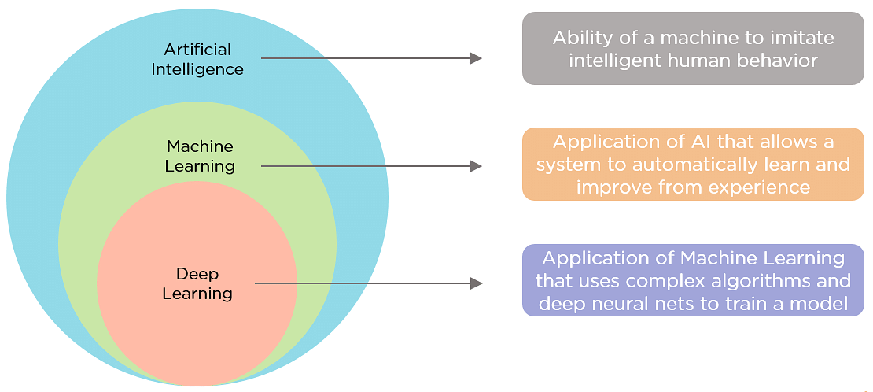
Machine learning vs deep learning

Slide 49
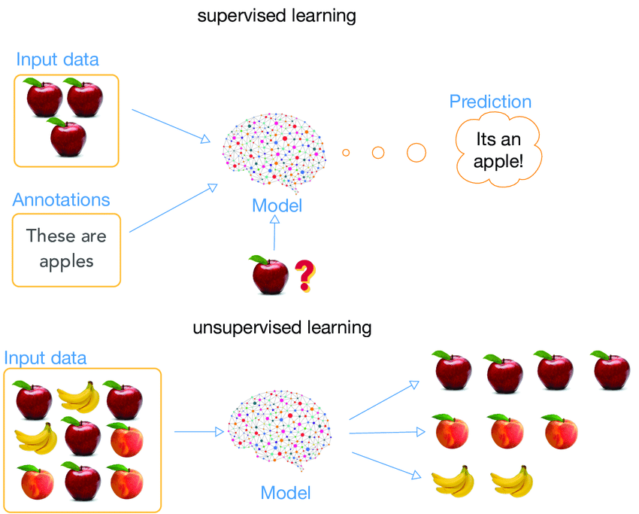
Tasks: Supervised learning vs unsupervised learning

Slide 50
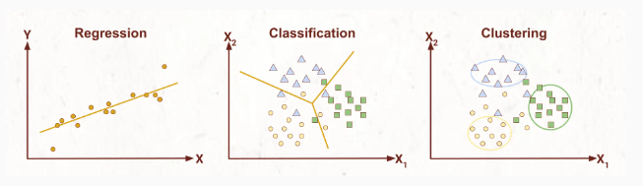
Regression vs classification vs clustering

Slide 51
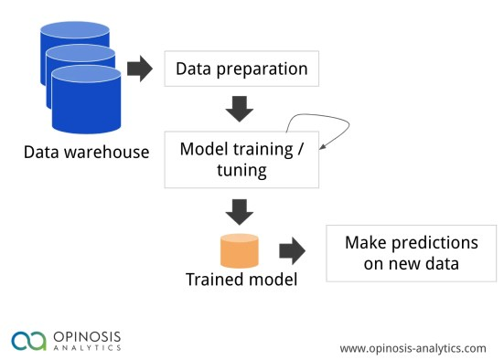
How to train a model?

Slide 52
Software Testing
Please take a look at this blog before the session tomorrow:
A Brief Introduction to Software Testing

Slide 53

Software Testing
How do you test your code?
How do you know it gives the right answers?
Add your ideas to the padlet:

Slide 54
Debugging and Improving Performance
Diagnosing problems
Identifying common errors
Evaluation of code performance
Vectorisation techniques
Managing memory effectively

Slide 55
Preallocation of Memory
Efficient matrix and array operations rely on data being located together in a contiguous block of memory addresses
Create a dummy version of a variable of appropriate size
>> A = zeros(m,n)
Subsequent operations then overwrite the zeros with the required values
Assigning the last element of an array first creates an array of the appropriate size
>> x(8) = 3
x =
0 0 0 0 0 0 0 3

Slide 56
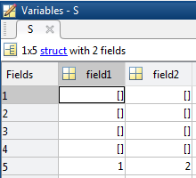
Preallocating Cells and Structures
Cell arrays and structure arrays act as containers for various types of data
>> c = cell(1,5)
The cell command preallocates the container
c
Define the last element in a structure array
>> S(5).field1 = 1;
>> S(5).field2 = 2;

Slide 57
In-Place Optimisation
In-place optimisation saves on memory by reusing an input variable for output
y = 2*x + 3;
x = 2*x + 3; Saves memory by assigning back into variable x and execution time for allocating memory
Functions
....
x = myfun(x)
....
Regular Function
In-Place Optimisation
Function y = myfun(x)
y = 2*x + 3;
Function x = myfun(x)
x = 2*x + 3;
x
myfun
y
x
myfun

Slide 58
MATLAB Profiler with Flame Graph video

Slide 59

Feedback
We really value your feedback, which you can provide by completing this short survey​
​
Course date as 06/06/2024​
Course code as GSTML3

Slide 60
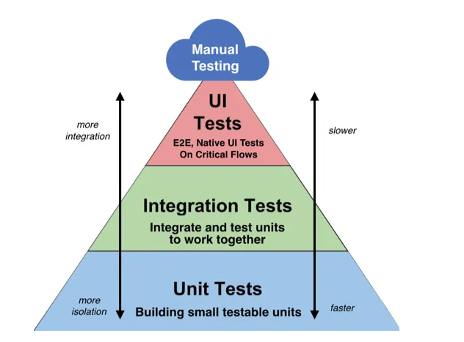
Different levels of software testing
Figure source: Lawrence Tan “Unit Tests, UI Tests, Integration Tests & End-To-End Tests” Medium, September 19, 2019

Slide 61
Unit Testing
Test individual code units in isolation from the rest of the system
Test that each unit works as intended
Identify bugs early in the development process
Makes it easier to refactor code
Facilitates collaboration
May be manual or automated
Automation frameworks are used to perform multiple tests.

Slide 62
How would we test this function works correctly?
function [distance] = DistBetweenPoints(p1x, p1y, p2x, p2y)
% Function to calculate distance between 2 points
% Input: x and y coordinates of two points - can be integer or floating
% point. Can be vectors of points
% Output: The distance between the points
if ( (p2x-p1x) == 0 && (p2y-p1y) == 0)
error("Single point");
end
distance = sqrt( (p2x -p1x).^2 + (p2y-p1y).^2);
end

Slide 63
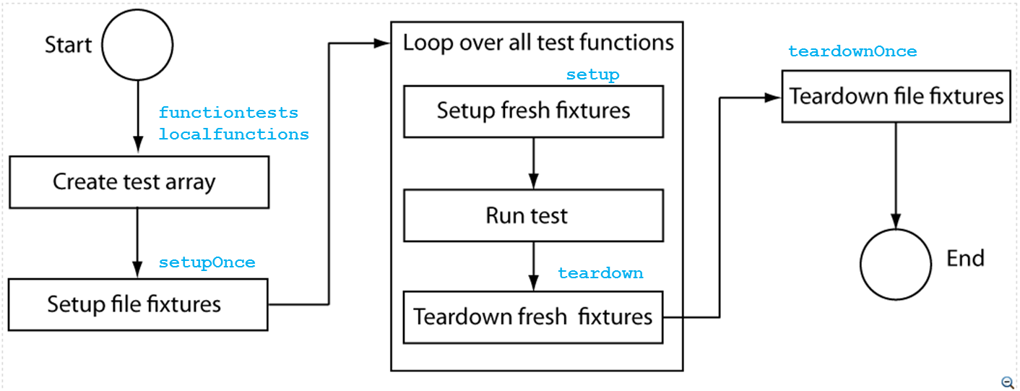
Task Execution

Slide 64
Main test function
Function tests = testFunction
tests = functiontests( localfunctions() );
End
function test_func1(testcase)
…
end
function test_func2(testcase)
…
end
Assembles cell array of function handles for local functions in current file

Slide 65
Feedback
We really value your feedback, which you can provide by completing this short survey​
​
Course date as 06/06/2024​
Course code as GSTML3

